Slide 1
HIV in Georgia
The Numbers Don’t Lie:
It’s Time to End Disparities
Carolyn McAllaster, Duke University School of Law
Director: Southern HIV/AIDS Strategy Initiative (SASI)
Nic Carlisle,
Executive Director: Southern AIDS Coalition (SAC)

Slide 2
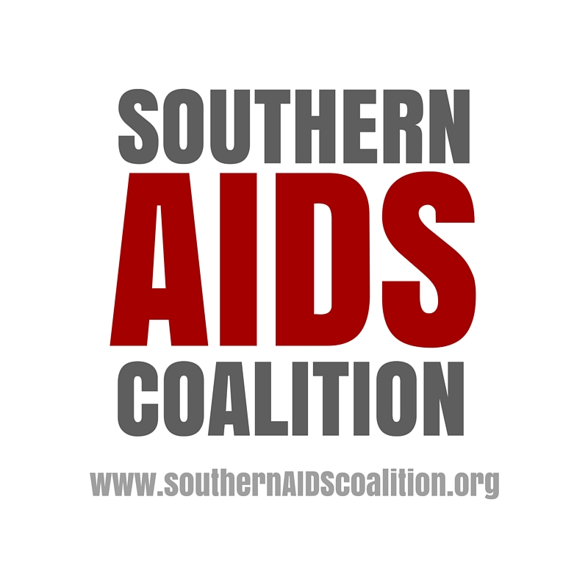

HIV and AIDS Statistics in Georgia
Georgia ranked 10th in the country in the number of deaths among people living with HIV in 2013.
Georgia ranked 5th in the country in the number of people living with HIV in 2013 with 42,067 individuals.
The number of men in GA who acquired HIV via male-to-male sexual contact increased by 42% from 16,986 men in 2008 to 24,101 men in 2013.
Georgia ranked 5th the country in the number of HIV diagnoses, reporting 2,247 cases in 2014.
(CDC Atlas Data, http://www.cdc.gov/nchhstp/atlas/)

Slide 3

SASI Analysis of CDC’s recent FOA for direct CBO funding (PS15-1502)
PS15-1502—CDC funding designed to reach areas with greatest need for HIV prevention services.
Restricts eligibility for direct funding to community based organizations (CBOs) to those located in designated metropolitan statistical areas—CBOs outside those areas are not eligible to apply for funding.
Notes:
SASI conducted an analysis of the most recent CDC HIV prevention funding announcement for direct funding to community based organizations (or CBOs), PS15-1502.
Direct funding to CBOs is important because CBOs are uniquely positioned to reach communities at risk, like young gay and bisexual men.
In the past (PS10-1003 [2010] and PA-04064), the CDC did not impose an explicit geographic eligibility requirement but rather expressed that prevention should “reflect local prevention priorities and serve persons at high risk for acquiring or transmitting HIV.” CDC had also expressed a preference for distributing funds in proportion to the HIV epidemic geographically.
PS15-1502, however, limited CBO eligibility for direct prevention funding to those CBOs located in designated large MSAs—eligible MSAs were listed in the funding announcement.
In 4 of our 9 Deep South States, the number of new HIV diagnoses that occur outside eligible MSAs is greater than the number that occur within eligible MSAs. (AL, MS, NC, SC).

Slide 4

SASI Analysis of % of PLWHA Living Outside an MSA eligible for CBO Funding from CDC
Notes:
[Based on eligible MSAs in FOA PS15-1502; data taken from 2012 CDC Surveillance Report.]
Map—Similarly, the percentage of people living with HIV who do not live in an eligible MSA is significantly greater than the percentage of HIV+ people who do live in an eligible MSA. In 4 of our states, more than 50% of PLWHA live outside an eligible Metropolitan Statistical Area (AL, MS, NC, SC)
The epidemic in those states is more diffuse—often in smaller urban areas as well as in more rural counties.

Slide 5
SASI Analysis of Funds Distributed to community based organizations in the US under the recent CDC funding opportunity (PS15-1502)
Notes:
SASI also analyzed the overall geographic distribution of PS15-1502 funds to community-based organizations.
A total of $40,615,001 in CDC funding was recently distributed under PS15-1502 to 83 community-based organizations in the US.
The South (as defined by the CDC)* received a total of $13,483,383 in funding representing 33% of the total funding to US CBOs.
New York and California combined received $14,794,561 in funding representing 36% of the total funding to US CBOs.
*The CDC uses the Census Bureau definition of the Southern US consisting of Alabama, Arkansas, Delaware, Florida, Georgia, Louisiana, Kentucky, Maryland, Mississippi, Oklahoma, North Carolina, South Carolina, Tennessee, Texas, Virginia, West Virginia, and the District of Columbia.

Slide 6
Comparison of new HIV diagnoses
Notes:
The South accounted for 51% of all new HIV diagnoses in the US in 2013;
New York and California combined accounted for 19% of all new HIV diagnoses in the US in 2013.
**based on 2013 CDC HIV Surveillance Report.

Slide 7
Comparison of HIV Prevalence
Notes:
*Based on 2013 CDC HIV Surveillance Report
The South had 43% of all people living with HIV in the US. NY and California combined had 27% of all people living with HIV in the US. (year-end 2012).

Slide 8
CDC’s Recent Funding Allocation to CBOs
Summary
Region/State | Total PS15-1502 Funding Amount Received | Percentage of Total US PS15-1502 Funding Received | Percentage of new HIV diagnoses in US (2013) | Percentage of People Living with HIV in US (year-end 2012)
United States | $40,615,001 | 100% | 100% | 100%
South | $13,483,383 | 33% | 51% | 43%
Deep South Region | $10,683,383 | 26% | 40% | 34%
Florida | $1,050,000 | 3% | 11% | 11%
New York & California | $14,794,561 | 36% | 19% | 27%
^{[1]}
Notes:
Deep South Region targeted by SASI (AL, FL, GA, LA, MS, NC, SC, TN, TX) is a big driver of the Southern HIV epidemic with 40% of new HIV diagnoses (2013) and 34% of people living with HIV (year-end 2012). This region received a total of $10,683,383 in PS15-1502 funding representing 26% of the total US funding.
Florida stands out. Florida ranked third in the country with 11% of the people living with HIV (year-end 2012) and 11% of all new HIV diagnoses in the US (2013).
Despite this, the entire state of Florida only received $1,050,000 in PS15-1502 funding (3% of the total US funding).

Slide 9
PS15-1502 Funding Eligibility in Georgia
Under PS15-1502, only CBOs in the Atlanta metropolitan area are eligible to apply for HIV prevention funding from the Centers for Disease Control and Prevention (CDC).
CBOs in other Georgia cities are not eligible for funding.

Slide 10
Consequences for Georgia
33.17% of people living with HIV in GA live outside of the Atlanta area, the only area eligible to apply for funding.
Only five Georgia-based CBOs received funding pursuant to PS15-1502.
Notes:
AID Atlanta; Empowerment Resource Center; Positive Impact; Recovery Consultants; St. Joseph’s Mercy Care Services (all in Atlanta)

Slide 11
Conclusions from SASI Analysis
Recent CDC funding to CBOs is inconsistent with the geographic distribution of the epidemic both within states and between regions.
Additional resources are needed for the South and within the South, for the large urban centers and the rural and smaller urban areas with heavy HIV burden.

Slide 12
SASI/SAC Toolkit
Take Action
  Write to CDC Prevention Director, Dr. Eugene McCray
  Letters to be delivered in bulk in April.
2-page Fact Sheet: Impact of Recent CDC Funding on Southern CBOs
Georgia Fact Sheet
Stationery and envelopes

Slide 13
Collect your own letters.
Toolkit on our website: http://southernaidsstrategy.org/take-action/
Campaign introductory letter
2-pager on Impact of CDC Funding
State-based fact sheet
Power point slides
Longer Report for more details

Slide 14
Follow the Work of the
Southern HIV/AIDS Strategy Initiative (SASI) and the Southern AIDS Coalition (SAC)
  Visit SASI’s website
    www.southernaidsstrategy.org
  Visit SAC’s website
    http://southernaidscoalition.org/

