Slide 1
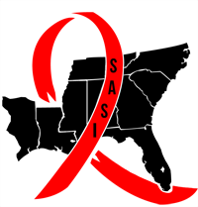
Southern HIV/AIDS Strategy Initiative (“SASI”): Focusing White House Attention on the HIV Epidemic in the South
Carolyn McAllaster
Clinical Professor of Law
Project Director, Southern HIV/AIDS Strategy Initiative
Director, Duke AIDS Law and Policy Clinic I Duke School of Law
mcallaster@law.duke.edu

Slide 2
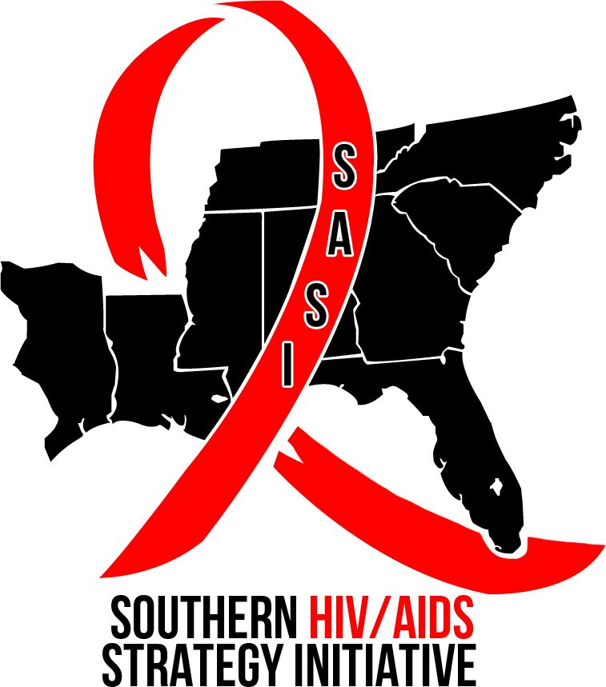
What is SASI ?
  Broad-based Southern Coalition
  advocating for increased federal resources targeting the HIV epidemic in the South
  Funded by the Ford Foundation

Slide 3


National HIV/AIDS Strategy
First ever.
Announced by President in July, 2010.
Strategy acknowledge that the South is a region “disproportionately impacted by HIV”

Slide 4
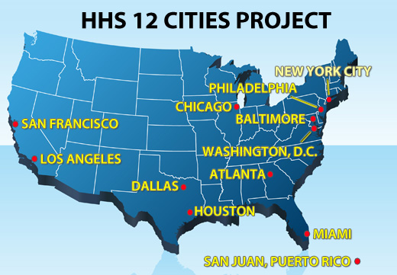

Slide 5

SASI Research Report
Worked with to create report documenting HIV epidemic in the South
Focused on 9 states:
AL, FL, GA, LA, MS, SC, NC, TN, East TX

Slide 6


SASI REPORT HIGHLIGHTS
HIV/AIDS Epidemic in the South Reaches Crisis Proportions in Last Decade
Duke Center for Health Policy and Inequalities Research
Susan Reif PhD, LCSW
Kathryn Whetten PhD, MPH
Elena Wilson MPH

Slide 7
New HIV Infections: The targeted States have the highest rates of new HIV diagnoses in the United States
Notes:
The South has the highest rate of new HIV cases (22.3), followed by the Northeast (19.6), the West (10.9), and the Midwest (10.0).
When the targeted states are added as a regional category, this region had the highest new HIV infection rate in 2009 (25.9).

Slide 8
Half of newly reported HIV infections were in the South although the South accounted for only 37% of the US population.

Slide 9
New AIDS Diagnoses: 8 of the targeted state with the highest AIDS diagnosis rates in 2009 are in the targeted States.
AIDS Diagnosis Rate, 2009
Ranking | State | AIDS Diagnosis Rate
1 | Washington DC | 119.8
2 | New York | 24.6
3 | Florida* | 23.7
4 | Maryland | 19.9
5 | Louisiana* | 19.4
6 | Delaware | 18.0
7 | New Jersey | 16.9
8 | South Carolina* | 15.6
9 | Georgia* | 14.1
10 | Mississippi* | 13.1
11 | North Carolina* | 11.6
12 | Tennessee* | 11.1
13 | Texas* | 10.7
14 | Nevada | 10.6
15 | California | 10.2

Slide 10
The Southern states account for 8 of the 10 states with the highest HIV death rates (deaths per 100,000 population). All nine targeted Southern states are among the 15 states with the highest death rates.
HIV Death Rates, 2008
Rank | State | HIV Death Rate
1 | Washington DC | 27.0
2 | Louisiana | 7.6
3 | Florida | 7.6
4 | Maryland | 7.3
5 | Delaware | 6.2
6 | New York | 6.0
7 | Mississippi | 5.4
8 | Georgia | 5.2
9 | South Carolina | 5.0
10 | New Jersey | 4.7
11 | Tennessee | 4.3
12 | Alabama | 3.9
13 | Texas | 3.7
14 | North Carolina | 3.7
15 | Nevada | 3.0
15 | Connecticut | 3.0

Slide 11

Why the high death rates?
Nine of the ten states with the worst health ratings are in the South.
General Health Status, 2011

Slide 12
Populations in the South that are particularly hard hit
WOMEN
  8 of 10 deep South states report higher proportion of women among new HIV infections
  85% of women were infected through heterosexual sex
  71% of women diagnosed with HIV in the South are African American

Slide 13
Populations in the South that are particularly hard hit (cont’d)
Populations in the South that are particularly hard hit (cont’d)
MEN WHO HAVE SEX WITH MEN (MSM)
  49% of those diagnosed with HIV in the targeted states in 2009 were MSM
  It is estimated that 1 in 5 African American MSM in the South are living with HIV

Slide 14
Populations in the South that are particularly hard hit (cont’d)
Populations in the South that are particularly hard hit (cont’d)
AFRICAN AMERICANS: 54% of new HIV cases among African Americans in the US were in the targeted states
HISPANICS/LATINOS: 50% of new HIV diagnoses among Hispanics/Latinos in the US were in the South

Slide 15
Populations in the South that are particularly hard hit (cont’d)
RURAL EPIDEMIC:
  64% of people with AIDS living in rural areas reside in the South

Slide 16
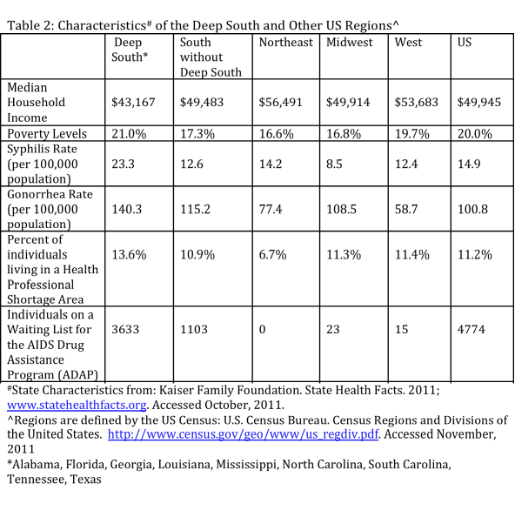
Possible Contributing Factors

Slide 17
What are we asking for?
c
c
c
It is urgent that the White House convene
a State of the South Task Force now
Next steps of the National AIDS Strategy must be directed at the South
The task force must identify opportunities across federal agencies to address the Southern HIV Epidemic
The task force must identify funding opportunities to evaluate best HIV prevention and care practices for the South

Slide 18
What You Can Do
Stay Informed and Take Action
  Sign up for the SASI Listserv
    https://lists.law.duke.edu/sympa/subscribe/sasilist
  Visit the SASI website
    www.southernaidsinitiative.org
      Sign the SASI petition
      Write the White House and Members of Congress
      Recruit community coalition partners for SASI

Slide 19
Thank you and Next Steps
Workshop this afternoon
Resources:
  SASI Website: www.southernaidsinitiative.org
  SASI e-mail: sasi@law.duke.edu
  SASI listserv: sasilist@law.duke.edu

